Slide 1
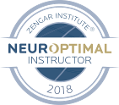
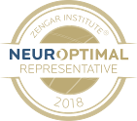
“I’ve never been this happy!”
Personal transformation story of
Sonia Walker
Craig Walker, Certified Advanced NeurOptimal® Trainer, Instructor and Representative

Slide 2
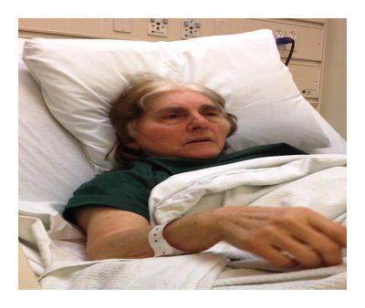
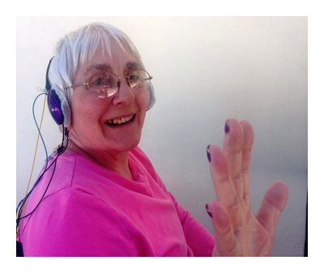
Images: Before Training vs After

Slide 3
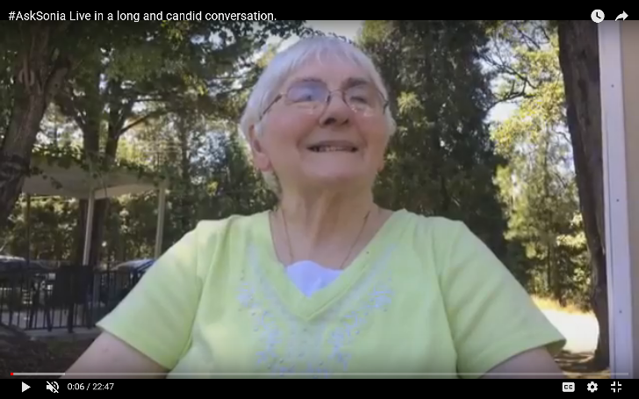
Introduction
Sonia’s life history and presenting issues

Slide 4
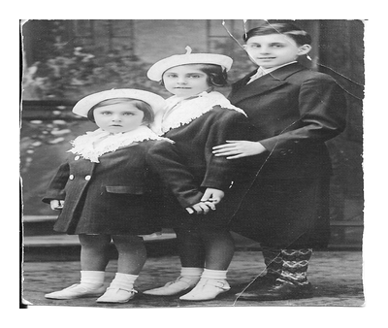
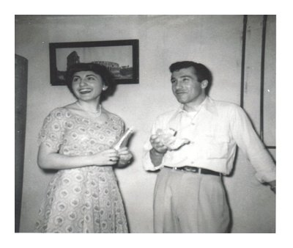
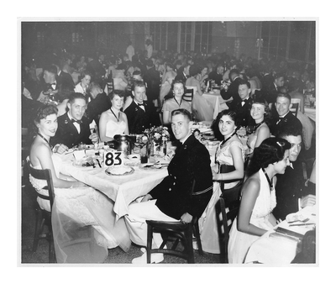
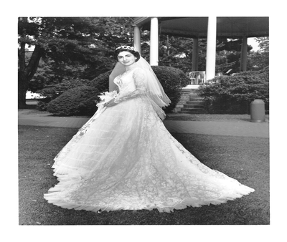
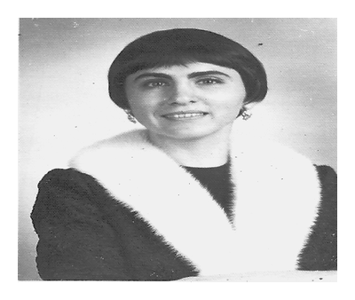
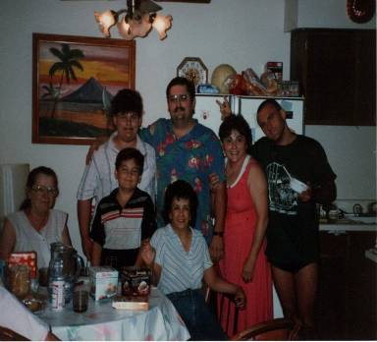
Her Life in Images

Slide 5
Alzheimer’s Diagnosis August, 2015

Slide 6
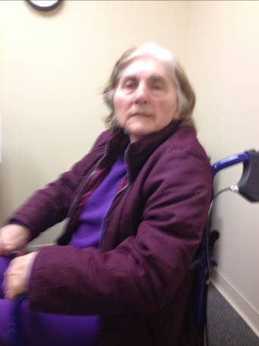
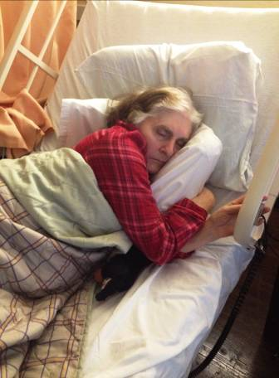
Not Who I Remember
Confused, disoriented
Spent most of her time isolated and sleeping
Unhappy

Slide 7
Pre NO – Preparing for the worst
February, 2015 – Is this the end?
A year of worry and then, NO2 Professional purchased for another reason in

Slide 8
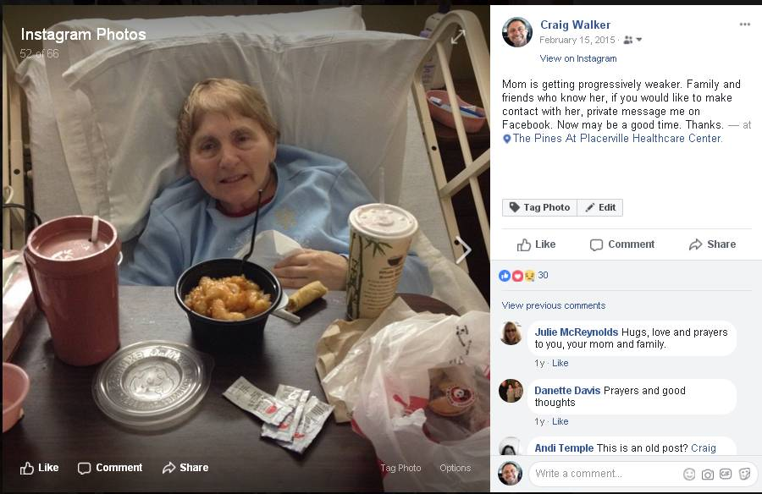
Facebook Post February 15, 2015

Slide 9
The Experiment – Will NO help?
Began training her in March, 2016
Two sessions a week

Slide 10
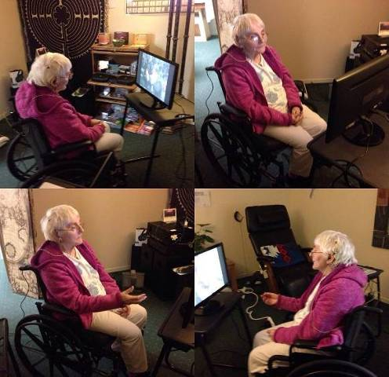
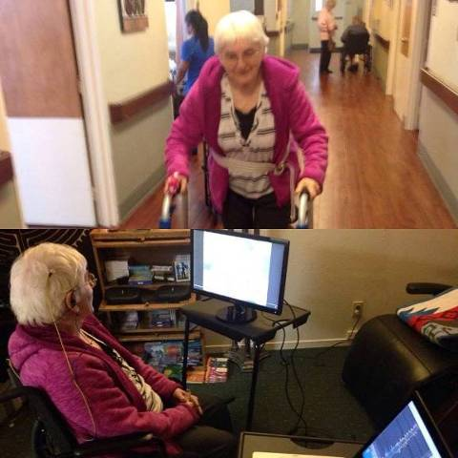
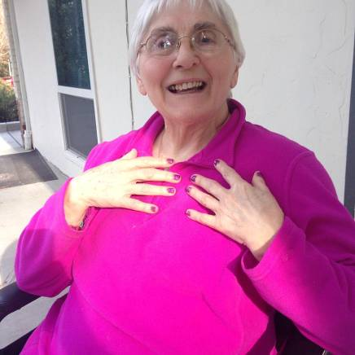
The Beginning – March, 2015
Hopeful results within 10 sessions
Lifelong and extreme nail biting habit ceased
Happier, more engaged

Slide 11
Sonia’s NO Journey
Began doing daily sessions and used her favorite music
No offense, and much love to Jeff Bova but she looked forward to sessions, each and every day
Spectacular results!
100 Sessions met – Alan Bacher’s standard

Slide 12
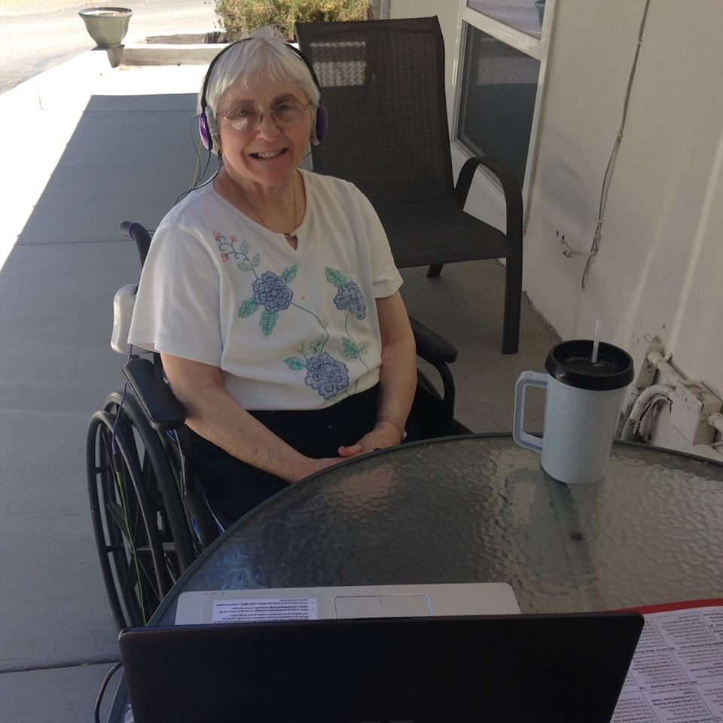

Slide 13
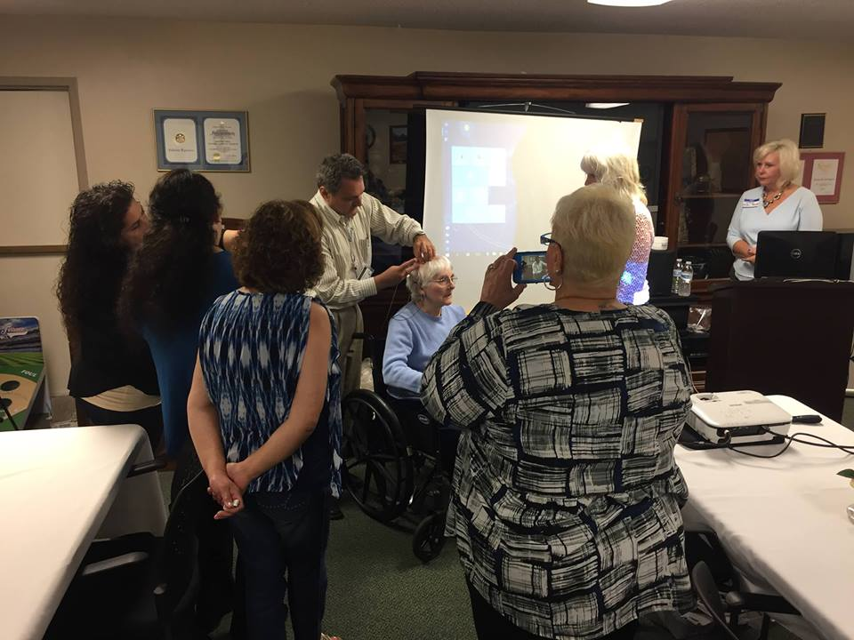

Slide 14
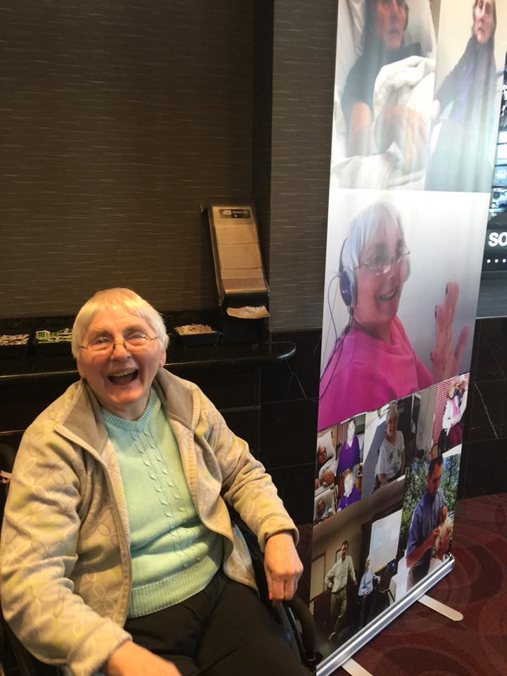

Slide 15
Results and what now?
Over 100 sessions
Occasional “tune ups” now and then
All gains remain
Where do we go from here?

Slide 16
Reources and Q&A
https://youtu.be/Txwe18cRKZA?list=PLDQ6zYqh1nGNeWT0I_-cCCMw7QCGouE0V - #AskSonia YouTube Playlist
https://youtu.be/EnS3kst60g8 #AskSonia tells her life story

Slide 17
Thank you and “Bye” From Sonia
Sonia can be reached at: The Pines at Placerville Healthcare Center 1040 Marshall Way Placerville, CA 95667 (530) 622-3400

